Slide 1

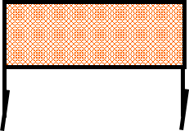
 | 2020 Movember Charity Classic Bay 5 What’s Behind the Walls? Course Designer: Dave McClure
START POSITION: Standing outside the shooting area, toes touching marks, wrists below belt, facing anywhere downrange. Gun loaded and holstered. PCC: Standing outside the shooting area, toes touching marks, facing anywhere downrange. Gun loaded, stock touching belt, muzzle pointed anywhere downrange.
STAGE PROCEDURE: At the start signal, engage targets as they become visible from within the shooting area. |  | SCORING: Unlimited, 30 rounds TARGETS: 15 IDPA SCORED HITS: Best 2 per paper START-STOP: Audible - Last shot
Tree
Tree
port
x x

